Slide 1


Titolo presentazione sottotitolo
Projects – Applied Statistics a.y. 2022/23
Team #2 – Analysis of the PISA dataset.
Milano, XX mese 20XX
Leonardo Cesani
Lorenzo Franzè
Valentina Manzoni
Benjamin Natali
Benedetta Zamboni
Tutor: Chiara Masci & Alessandra Ragni

Slide 2
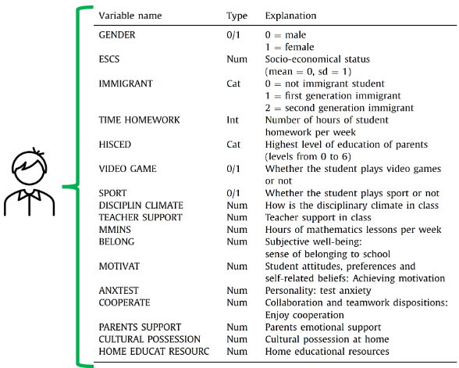
Dataset
The PISA dataset collects data about the academic knowledge and real-life skills of 15 years-old students around the world (https://www.oecd.org/pisa/data/).
The main data files are:
Students-questionnaire.
School-questionnaire.
Teacher-questionnaire.
We will focus on the Students-questionnaire.

Slide 3

Research Question
We want to investigate if there are any relationships in motivation and academic performances in 15 years-old students participating the PISA Study. Furthermore, we would like to understand what drives motivation and if such drivers are the same across different countries.

Slide 4
How do we define motivation
We isolated the features (numerical indicators) that we thought would be representative of the motivation:
Index | Description
Expected occupation. | Expected occupational status based on the level of education.
Parents support. | Parent’s emotional support perceived by the students
Competitiveness at school. | How competitive a school is and the students attending it.
Cooperation at school. | Perception of cooperation at school.
Competitiveness of student | How much the student define himself competitive.
Fear of failure. | Perception of fear of failure at school.
Resilience. | How a student is prone to recover quickly from difficulties.
Desire to master knowledge. | Summarizes the student desire to learn and understand the content of classes.

Slide 5
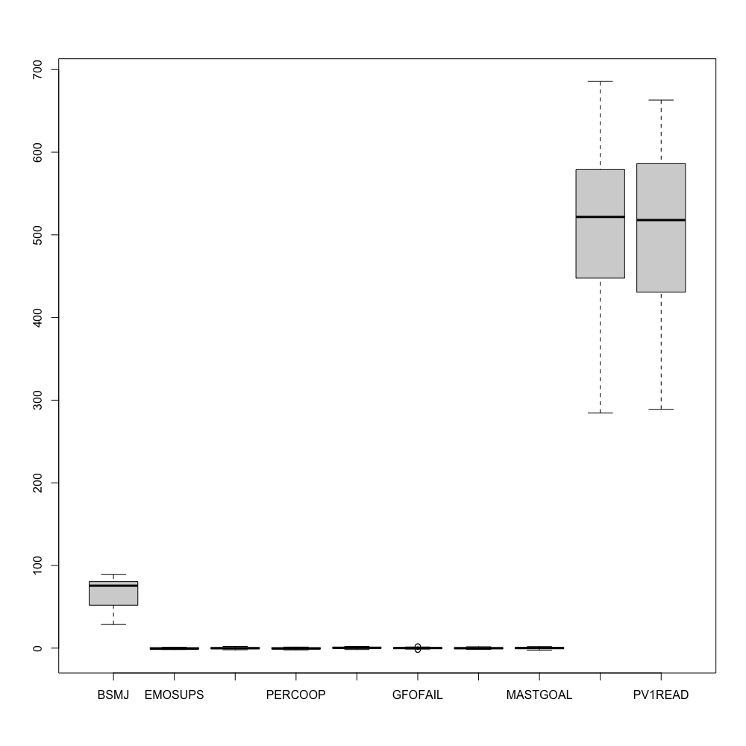
Preliminary analysis
First steps:
Select the features’ columns and rename them.
Eliminate the NA values.
Convert all strings in numerical values.
Visualize data with boxplot.
Test hp of multivariate normality.
Since the dataset has too many observations, the plot is based only on data from one country (“Italy”).

Slide 6
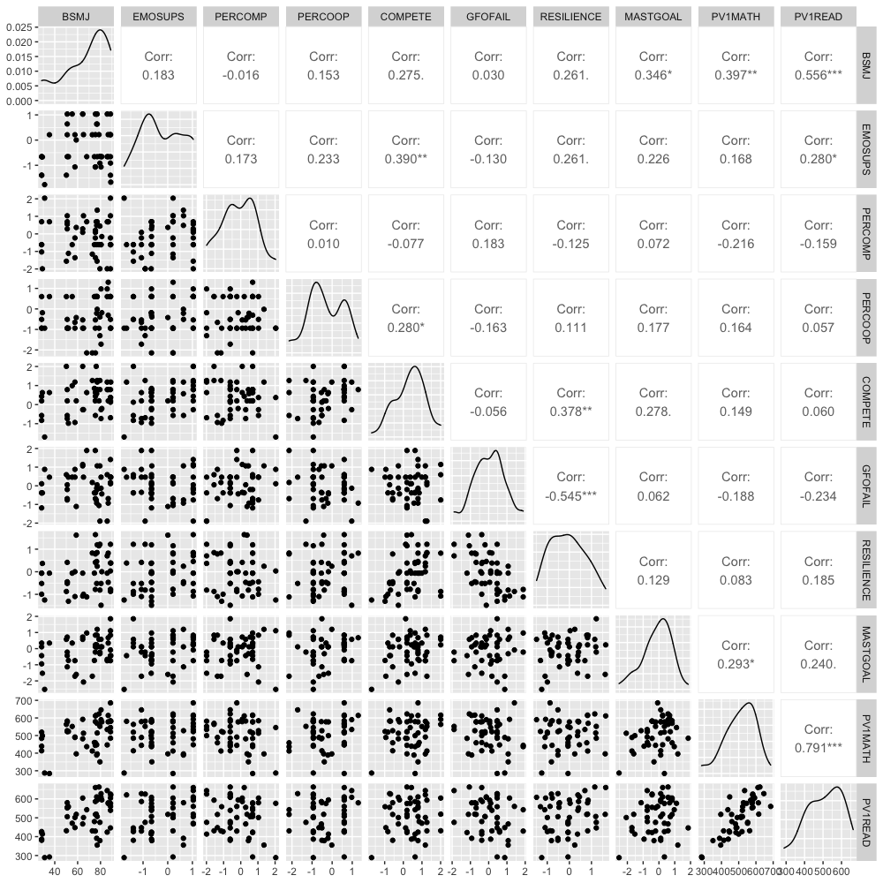

Slide 7
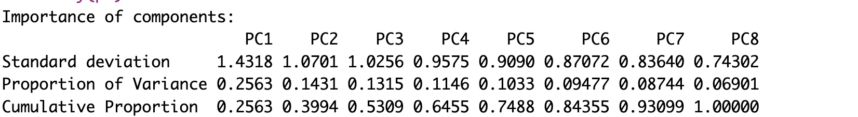




PCA
PCA of the 7 components.
Results:
PCA on the sample covariance is not significant due the masking effect of variable 1.
Scaled PCA show poor results since there is no possible dimensionality reduction that explains enough variability.

Slide 8
GOALS & IDEAS
In the future we would like to explore the following ideas:
Multilevel analysis (mixed effect models) to see what factors influence motivation across different countries.
Attempt of MANOVA with different levels of PVMATH as factors.
2 way MANOVA with PV1MATH and PV1READING.
Clustering to see possible groupings based on motivational factors.
Non parametric approach to bypass normality hp.

